Slide 1
Algorithms for solving the symmetry number on trees
Pradipta Prometheus Mitra, Muhammad Arshad Ul Abedin,
Md. Abul Kashem
Information Processing Letters 91 (2004) 163–169
Presenter: Mao-Yuan Kao
Date: May 4, 2006

Slide 2
Abstract
The symmetry number of a tree is defined as the number of nodes of the maximum subtree of the tree that exhibits axial symmetry. Chin and Yen have presented an algorithm for solving the problem of finding the symmetry number of unrooted unordered trees in time O(n⁴). In this paper we present an improved algorithm for solving the symmetry number problem on trees that runs in time O(n³).

Slide 3
The Symmetry Number of a Tree
the symmetry number of a tree is the size (number of nodes) of the maximum subtree which exhibits axial symmetry.
(A tree is said to have an axial symmetry if we can draw (in the fashion of upward drawing) the tree together with an axis such that each node (and edge) has a unique corresponding image on the opposite side of axis.)
The symmetry number problem:
Given a tree G and a number k, deciding whether the symmetry number of G is greater than or equal to k.

Slide 4
Symmetry Drawing
8
4
7
9
4
6
5
3
6
5
3
7
9
2
2
8
1
3
Symmetry axis
4
2
5
1
Symmetry axis

Slide 5
Weighted Matching
the weighted matching problem which is defined as follows:
A matching M on a graph G = (V ,E) is a subset of E (i.e., M ⊆ E) such that any two edges in M have no common vertex.

Slide 6
Maximum Weighted Matching
12
A
D
4
5
Weighted matching problem
on the complete graph.
2
2
B
10
C
Weight of maximum matching=22
A
B
C
5
1
Weighted matching problem
on the complete bipartite graph.
7
6
Weight of maximum matching=18
D
E
F

Slide 7
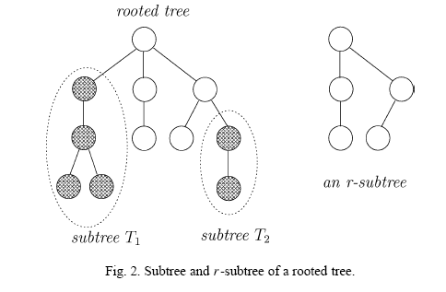
R-Subtree
An r-subtree of T is a rooted tree generated from T by cutting off some of T ’s subtrees. (See Fig. 2 for an example of an r-subtree by cutting off subtrees T1 and T2.)

Slide 8
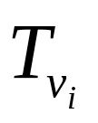

Procedure A(v_{i})
It returns the number of nodes in the maximum r-subtree of subject to the constraint that
being on the symmetry axis.
1
2
3
4
5
Max symmetric r-subtree
A(1)=5, A(3)=2
6

Slide 9
Procedure A(v_{i})
Procedure A(v_{i})
1: if vi is a leaf node then
2: return 1;
3: else
4: construct a weighted complete graph Gvi = (V ,E) with
weight function w such that
V = {vi} ∪ Cvi {Cvi is the set of vi ’s children},
wil = A(vl ), ∀vl ∈ Cvi , and
wpq = 2B(vp,vq ),∀vp,vq ∈ Cvi ;
5: return 1+ (weight of maximum matching of Gvi );
6: end if

Slide 10
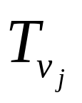
Procedure B(v_{i},v_{j})
It returns the size of the maximum common r-subtree of and .
1
isomorphic
2
3
B(2,3)=4, B(4,8)=1
4
5
6
7
8
9
10
11

Slide 11
Procedure B(v_{i},v_{j})
Procedure B(vi,vj )
1: if vi or vj is a leaf node then
2: return 1;
3: else
4: construct a weighted complete bipartite graph Gvi ,vj = (Vi ∪ Vj,E)
with weight function w such that
Vi = Cvi , Vj = Cvj , and
wpq = B(vp,vq ), ∀vp ∈ Vi and ∀vq ∈ Vj ;
5: return 1+(weight of maximum matching of Gvi ,vj );
6: end if

Slide 12
Symmetry number problem[2]
1
If it is a leaf node
then return 1
2
3
1
5
3
A(2)
B(2,3)
2
3
4
5
6
7
8
9
8
A(1)=8+1
10
11

Slide 13
Symmetry number problem[2] cond.
If any one node is a leaf node
then return 1
1
6
7
2
3
2
1
4
5
6
7
8
9
8
9
B(2,3)=3+1
10
11

Slide 14
Symmetry number problem[2] cond.
1
1
2
1
1
2
2
3
4
7
2
2
4
5
6
7
8
9
5
6
2
A(2)=4+1
10
11

Slide 15
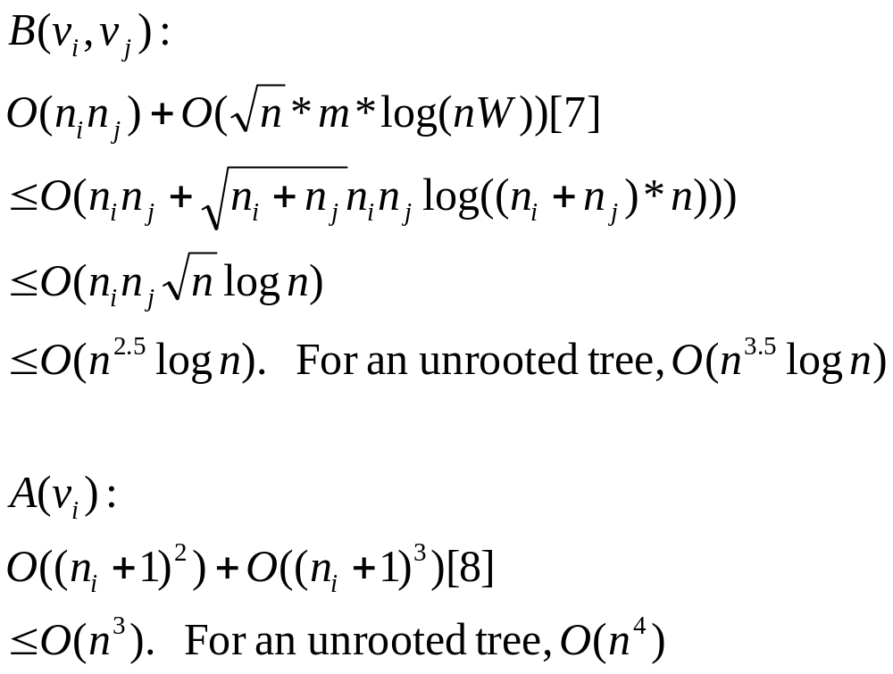
Time Complexity[2]

Slide 16
Improved B(v_{i},v_{j})
divide the tree in three parts with respect to the two nodes vi and vj . Note that the bold lines connecting vi with Part A and vj with Part C may be a set of edges. However, lines connecting vi and vj with Part B denote strictly one edge.
Part B
v_{i}
v_{j}
Part A
Part C

Slide 17
Improved B(v_{i},v_{j})
1
v_{i}
2
3
4
v_{j}
Part B
Part B
4
5
6
7
8
Part A
3
Part C
v_{i}
v_{j}
1
v_{i}
2
4
v_{j}
Part A
Part C
4
5
6
7
8

Slide 18
Improved B(v_{i},v_{j})
Lemma 3.1. The function B(vi, vj ) will never be required to be computed when the root or
of the tree is completely in either Part A or Part C.
Lemma 3.2. The value of B(vi, vj ) is unique if the root is in Part B.

Slide 19
Improved B(v_{i},v_{j})
Theorem 3.3. Given vi and vj , the values of all B(vi, vj ) required to be computed by the algorithm are the same.
As B(vi, vj ) has to be calculated only once for each
node pair, the total cost of computing all B(vi, vj )’s is O(n^{2.5} log n), instead of O(n^{3.5} log n).

Slide 20
Improved A(v_{i})
v_{i}
Let a node vi have ni neighbors.
Situation 1:
If v_{i} itself is the root of the tree,
there is 1 distinct A(v_{i})’s
Situation 2:
If a neighbor of v_{i} is the root,
there are a total of n_{i} distinct A(v_{i})’s
1
…..
n_{i}
v_{k}
v_{i}
There are the other of
v_{i}’s neighbors excepted v_{k}

Slide 21
Improved A(v_{i})
v_{j}
v_{k}
v_{i}
Situation 3:
If v_{j} is the root of the tree
which is neither v_{i} nor any of its neighbors,
v_{i} must be reached from v_{j} through any one of v_{i}’s neighbors v_{k}.
This value of A(vi) will be essentially equal to the value of A(vi) with vk as the root.
In other words, whatever the root of the tree, the parent of vi must either be null (when it is itself the root), or one of it’s neighbors. So, the total number of distinct A(vi )’s is n_{i} + 1.
There are the other of
v_{i}’s neighbors excepted v_{k}

Slide 22
Improved A(v_{i})
total number of distinct A(vi )’s (for the whole tree) is
∑
(
n
+
1
)
i
v
i
∈
V
=
∑
n
+
∑
1
=
∑
deg(
v
)
+
n
i
i
v
i
∈
V
v
i
∈
V
v
i
∈
V
=
2
(
n
−
1
)
+
n
=
3
n
−
2
The
total
number
of
distinct
A
(
v
)'
s
,
i
for
all
the
possible
roots,
to
be
caculated
is
3n
-
2.
the total cost for calculating all A(v)’s for
all v ∈ V (T ) is O(n³) which is the total time complexity of the algorithm.

Slide 23
References
[1] G. Battista, P. Eades, R. Tamassia, I. Tollis, Graph Drawing: Algorithms for Visualization of Graphs, Prentice Hall, New York, 1999.
[2] K. Chin, H. Yen, The symmetry number problem for trees, Inform. Process. Lett. 79 (2001) 73–79.
[3] T.H. Cormen, C.E. Leiserson, R.L. Rivest, Introduction to Algorithms, MIT Press, Cambridge, MA, 1998.
[4] H. Gabow, Data structures for weighted matching and nearest common ancestors with linking, in: Proc. of the 1st Annual ACM–SIAM Symp. on Discrete Algorithms, 1990, pp. 434–443.
[5] H.N. Gabow, A scaling algorithm for weighted matching on general graphs, in: Proc. of the 26th Annual Symposium of the Foundations of Computer Science, 1985, pp. 90–100.
[6] H.N. Gabow, R.E. Tarjan, Faster scaling algorithms for general graph matching problems, J. ACM 38 (1991) 815–853.
[7] H.N. Gabow, R.E. Tarjan, Faster scaling algorithms for network problems, SIAM J. Comput. 18 (5) (1989) 1013–1036.
[8] E. Lawler, Combinatorial Optimization: Networks and Matroids, Holt, Rinehart and Winston, New York, 1976.
[9] J. Manning, M. Atallah, Fast detection and display of symmetry in trees, Congr. Numer. 64 (1988) 159–169.
[10] C.H. Papadimitrou, K. Steiglitz, Combinatorial Optimization: Algorithms and Complexity, Prentice Hall, New York, 1982.
[11] J.Manning, Geometric symmetry in graphs, Ph.D. Dissertation, Dept. of Computer Science, Purdue University, West Lafayette, IN, 1990.

